Slide 1
Employee Data Analysis using Excel
STUDENT NAME : B. DIVYA DHARSHINI
REGISTER NO : 312211160
DEPARTMENT : B COM(BANK MANAGEMENT)
COLLEGE : DR MGR JANAKI COLLEGE OF ARTS AND SCIENCE
FOR WOMEN

Slide 2
PROJECT TITLE
Employee Performance Analysis using Excel

Slide 3


AGENDA
Problem Statement
Project Overview
End Users
Our Solution and Proposition
Dataset Description
Modelling Approach
Results and Discussion
Conclusion
3/21/2024 Annual Review

Slide 4

PROBLEM STATEMENT
Employee Performance Analysis using excel
Focus on employee growth
Well performance to get increment

Slide 5

PROJECT OVERVIEW
Analysis the performance of the employee is a
Various factors like. Gender , Performance course,
Rating , Achievement ,so this based the identify the Analysis Performance data .

Slide 6




WHO ARE THE END USERS?
MANAGER
EMPLOYEE
IT SECTOR

Slide 7

OUR SOLUTION AND ITS VALUE PROPOSITION
Conditional formatting - missing
Filter - remove
Formula - performance
Pivot - summary
Graph - data visualisation

Slide 8
Dataset Description
EMPLOYEE - KAGGLE
26 FEATURES,
9 FEATURES
EMPLOYEE ID - NUMERICAL
NAME - TEXT
EMPLOYEE - TYPE
PERFORMANCE LEVEL
GENDER - MALE, FEMALE
EMPLOYEE RATING - NUMERICAL VALUES

Slide 9

THE "WOW" IN OUR SOLUTION
Performance level = IFS(Z8>=5 “ Very high, “z8>z4
“High “ ,Z8>=8 ,”MEP “,True ,”Low”
3/21/2024 Annual Review
9

Slide 10
MODELLING
Data collection
surveys
Interviews
Observation
Focus groups
Features collection
features collection is a set of geographic objectives ,each represented by feature objectives.
Data cleaning
Missing value identify
Missing value filter out
10

Slide 11
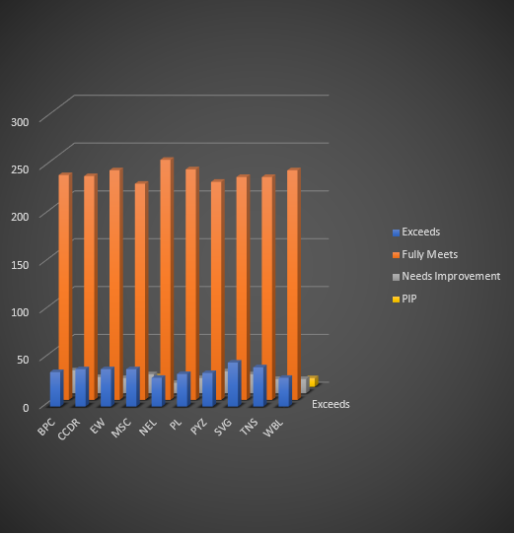
RESULTS
11

Slide 12
conclusion
“ Overall has demonstrated (strength / areas for improvement ) and has shown potential for growth and development within the organisation”.
“ Based on the performance analysis , has met/exceeded/fallen short of expectation, improvement have been outlined

